Slide 1

Daan Keun
Edwin Fullard
@daan_keun
@edisonfully

Slide 2


Slide 3
What is the Entelect Challenge?
The Biggest Coding Challenge in South Africa - 7th Year Running
R 200 000 in cash prizes
Based on retro and classic games
Calling professionals, enthusiasts, and students
Players build intelligent bots to play a game
Logic and problem solving
Development skills
Possibly Try Artificial Intelligence

Slide 4

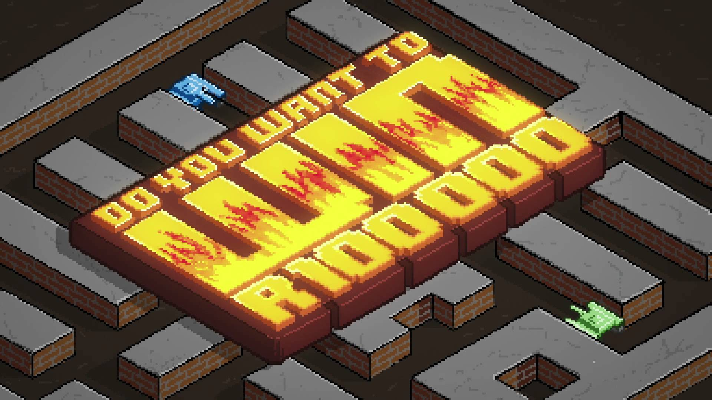
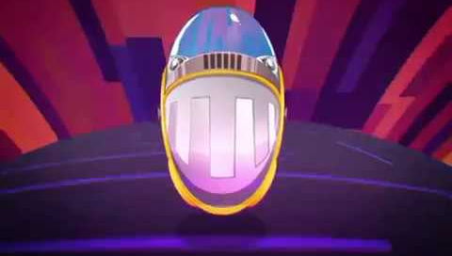



HISTORY
2012 Tron
2013 Battle City
2014 Pacman
2015 Space Invaders
2016 Bomberman
2017 Battleships

Slide 5

UNIVERSITY CHALLENGE
One day hackathon – in July/August
Takes place online and at each participating university
Students want to compete in the challenge but have time constraints so we made something just for them
Teams of three
Winning team members win gaming laptops and cool tech for their university lab
+ tickets to join us at ComicCon

Slide 6
THIS YEAR – TOWER DEFENCE
THEMED ON COMMAND AND CONQUOR RED ALERT
MECHANICS BASED ON PLANTS VS ZOMBIES
DEFEND YOUR BASE AND ATTACK YOUR OPPONENT
ECONOMY MANAGEMENT & GAMEPLAY STRATEGY

Slide 7
TOURNAMENT FORMAT
Codename Renegade - round robin
11 June 2018
1st place gets a golden ticket to the finals
2nd place gets R2000
3rd place gets R1000
Operation Firestorm - round robin
30 July 2018
1st place gets a golden ticket to the finals
2nd place gets R2000
3rd place gets R1000
Countdown to Zero Hour - Double Elimination
9 September 2018
Final deadline for bot submissions
1^{st -} 6th place gets a golden ticket to the finals

Slide 8

TOURNAMENT FINALS
Battle of the Sole Survivor - Double Elimination
15 September 2018 @ 11:00, MAIN STAGE, COMIC CON AFRICA
1st place gets R70 000
2nd place gets R35 000
3rd place gets R25 000
4th place gets R25 000
5th place gets R10 000
6th place gets R10 000
7th place gets R10 000
8th place gets R10 000

Slide 9







FOR THE GEEKS - ARCHITECTURE
Tournament Manager
Java
MongoDB
Tournament API
Website & Player Portal
Angular 5+
Bot Runner
Java & Docker
Bot Source Files
Bot Compiled Files
Match Results
Azure Blob Storage
RabbitMQ Communication Layer
Java &
Spring
Bot Compiler
Java & Docker

Slide 10





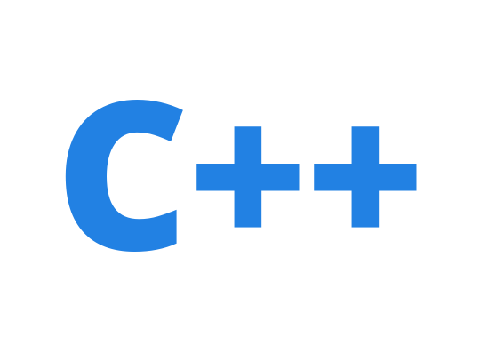





SUPPORTED LANGUAGES
Official
Java
C#
Python
JavaScript
Community
C++
Rust
Kotlin
PHP
Haskell
Golang
Deadline: 27th May

Slide 11
TOWER DEFENCE – RULES SUMMARY
EACH PLAYER STARTS WITH SOME Energy AND 100% HEALTH
PLAYERS CAN PLACE UNITS THAT COST ENERGY
UNITS HAVE ABILITIES SUCH AS ATTACK, DEFENCE or Energy generation
A PLAYER DOES ONE OF THE FOLLOWING EACH TURN:
NOTHING
PLACE ENERGY UNIT
PLACE ATTACK UNIT
PLACE DEFENCE UNIT
MORE TO COME…

Slide 12
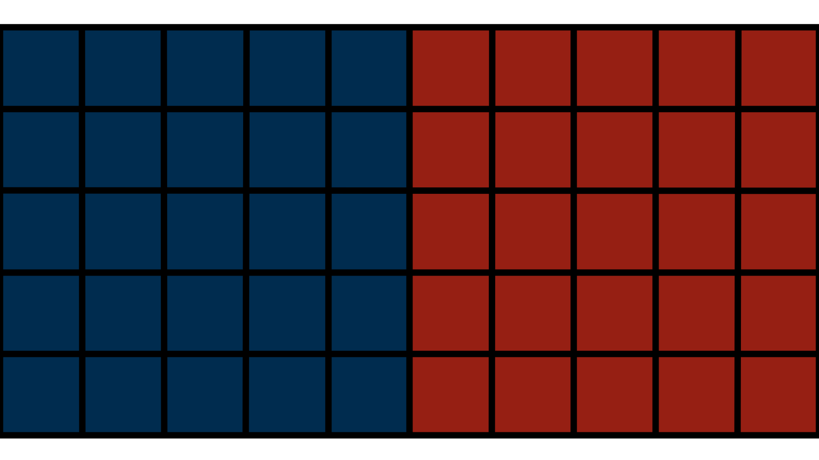
TOWER DEFENCE – RULES EXAMPLE
A
D
>
>
>
>
D
E
E
E
<
<
<
<
A
D
Player A places defense unit
Players wait for Energy
Player B places energy unit
Player A places defense unit
Player B places defense unit
Player A places energy unit
Player B places attack unit
Player A places energy unit
Player A places attack unit
Player B Defense unit takes a hit!
Player A base takes a hit!
Missile fired!

Slide 13

Let’s build a bot

Slide 14
Download the starter pack
https://github.com/ERFullard/ec-app-factory
We’re going to use the files in the starter-pack folder

Slide 15
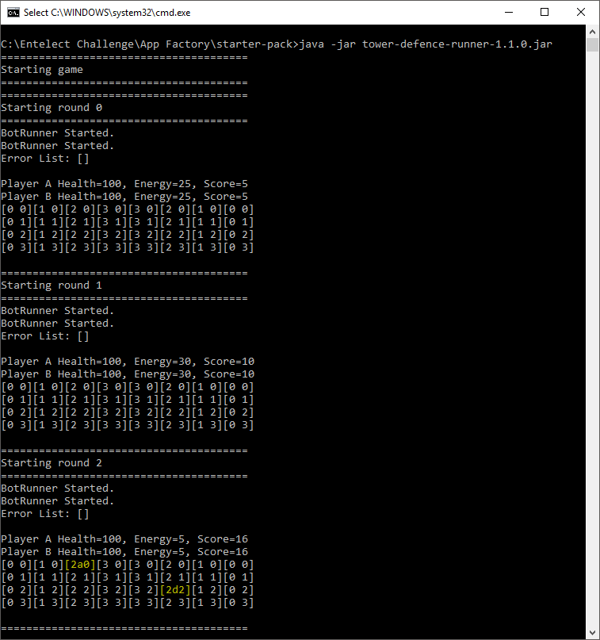

First Match
Double Click
run.bat

Slide 16
Config.json
{
"round-state-output-location": "./tower-defence-matches",
"game-config-file-location": "./game-config.properties",
"verbose-mode": true,
"max-runtime-ms": 2000,
"player-a": "./starter-bots/java",
"player-b": "./reference-bot/java"
}

Slide 17
Change Config.json
{
"round-state-output-location": "./tower-defence-matches",
"game-config-file-location": "./game-config.properties",
"verbose-mode": true,
"max-runtime-ms": 2000,
"player-a": "./starter-bots/java",
"player-b": "./reference-bot/java"
}
"player-a": "./starter-bots/javascript",

Slide 18
bot.json
{
"author": "John Doe",
"email": "john.doe@example.com",
"nickName": "Brendan",
"botLocation": "/",
"botFileName": "StarterBot.js",
"botLanguage": "javascript"
}

Slide 19
Add your details
{
"author": "John Doe",
"email": "john.doe@example.com",
"nickName": "Brendan",
"botLocation": "/",
"botFileName": "StarterBot.js",
"botLanguage": "javascript"
}

Slide 20
StarterBot.js
function initBot(args) {…}
function initEntries() {…}
function runStrategy() {…}
function doNothingCommand() {…}
function writeToFile(filename, payload) {…}

Slide 21
StarterBot.js
function runStrategy() {
doNothingCommand();
}
function doNothingCommand() {
writeToFile(commandFileName, ``);
}

Slide 22
StarterBot.js
function writeToFile(fileName, payload) {
fs.writeFile('./' + fileName, payload, function (err) {
if (err) {
return console.log(err);
}
});
}

Slide 23
Let’s start building
function runStrategy() {
if (hasEnoughEnergyForMostExpensiveBuilding()) { buildRandom();
} else {
doNothingCommand();
}
}

Slide 24
Let’s start building
function hasEnoughEnergyForMostExpensiveBuilding() {
return (myself.energy >= Math.max(...buildingPrices));
}

Slide 25
Let’s start building
function buildRandom() {
let emptyCells = cells
.filter(c => c.buildings.length == 0 && c.x <= (mapSize.x / 2) - 1);
if (emptyCells.length == 0) {
doNothingCommand();
return;
}
let randomCell = getRandomFromArray(emptyCells);
…

Slide 26
Let’s start building
…
let command = {x: '', y: '', bt: ‘’};
command.x = randomCell.x;
command.y = randomCell.y;
command.bt = getRandomInteger(2);
buildCommand(command.x, command.y, command.bt);
}

Slide 27
Let’s start building
function buildCommand(x, y, bt) {
writeToFile(commandFileName, `${x},${y},${bt}`);
}

Slide 28
Defending our base
function runStrategy() {
if (isUnderAttack()) {
defendRow();
} else if (hasEnoughEnergyForMostExpensiveBuilding()) {
buildRandom();
} else {
doNothingCommand();
}
}

Slide 29
Defending our base
function isUnderAttack() {
let myDefenders = buildings
.filter(b => b.playerType == 'A' && b.buildingType == 'DEFENSE’);
let opponentAttackers = buildings
.filter(b => b.playerType == 'B' && b.buildingType == 'ATTACK’)
.filter(b => !myDefenders.some(d => d.y == b.y));
return (opponentAttackers.length > 0) && (myself.energy >= buildingPrices[0]);
}

Slide 30
Defending our base
function defendRow() {
let myDefenders = buildings
.filter(b => b.playerType == 'A' && b.buildingType == 'DEFENSE’);
let opponentAttackers = buildings
.filter(b => b.playerType == 'B' && b.buildingType == 'ATTACK’)
.filter(b => !myDefenders.some(d => d.y == b.y));
if (opponentAttackers.length == 0) {
buildRandom();
return;
}
…

Slide 31
Defending our base
…
let rowNumber = opponentAttackers[0].y;
let emptyCells = cells
.filter(c => c.buildings.length == 0 &&
c.x <= (mapSize.x / 2) - 1 &&
c.y == rowNumber);
if (emptyCells.length == 0) {
buildRandom();
return;
}
…

Slide 32
Defending our base
…
let command = {x: ‘’ , y: ‘’ , bt: ‘’};
command.x = getRandomFromArray(emptyCells).x;
command.y = rowNumber;
command.bt = 0;
buildCommand(command.x, command.y, command.bt);
}

Slide 33
JOIN TODAY
WEBSITE CHALLENGE.ENTELECT.CO.ZA
FORUM FORUM.ENTELECT.CO.ZA
GITHUB GITHUB.COM/ENTELECTCHALLENGE
EMAIL CHALLENGE@ENTELECT.CO.ZA

